Slide 1
Building Application In Android Lollipop
View Android Development course details at www.edureka.co/android-development-certification-course
For Queries:
Post on Twitter @edurekaIN: #askEdureka
Post on Facebook /edurekaIN
For more details please contact us:
US : 1800 275 9730 (toll free)
INDIA : +91 88808 62004
Email Us : sales@edureka.co

Slide 2
Objectives
In this webinar, we will discuss:
What's new in Android Lollipop
Material Design And UI Components
RecyclerView & Palette API in Lollipop
Android Runtime (ART)
Compatibility and Support Libraries

Slide 3
Android History

Slide 4
Android 5.0 History
Preview “L” revealed during I/O 2014
API Level 20
Preview images
November 2014
Final API Level 21
Firmware Downloads for Nexus devices Nexus 6/9 “available”
Notes:
Title and Content Slide – Font: Tahoma 12/14 (depending on the amount of text)
Heading: Calibri Heading 26 (consistent)
Bullet code – 174 for bullet
OOBB for sub bullet

Slide 5
Material Design and Components

Slide 6
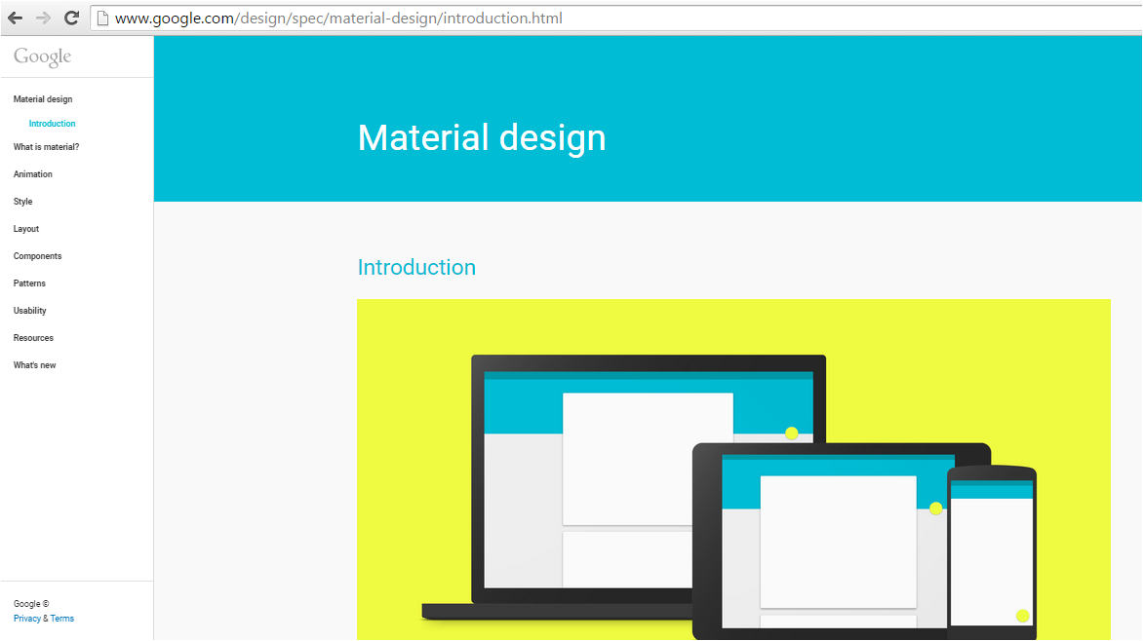
Material Design Principles
There is more http://www.google.com/design/spec/material-design/introduction.html
Design Guidelines
guidelines
Notes:
Title and Content Slide – Font: Tahoma 12/14 (depending on the amount of text)
Heading: Calibri Heading 26 (consistent)
Bullet code – 174 for bullet
OOBB for sub bullet

Slide 7
Material Design Principles 1/2
Colors
Large areas, suggested color palette
3D
Mostly 2D & 2.5D to give structure
Images
More personal & emotional content
Light and Shadow
Cards and Overlays
guidelines
Notes:
Title and Content Slide – Font: Tahoma 12/14 (depending on the amount of text)
Heading: Calibri Heading 26 (consistent)
Bullet code – 174 for bullet
OOBB for sub bullet

Slide 8
Material Design Principles 2/2
Flat
No bevels, gradients, effects
Typography
Roboto and font style definitions
Animations
Explains interaction
Layout templates
Margins, key lines, etc.
guidelines
Notes:
Title and Content Slide – Font: Tahoma 12/14 (depending on the amount of text)
Heading: Calibri Heading 26 (consistent)
Bullet code – 174 for bullet
OOBB for sub bullet

Slide 9
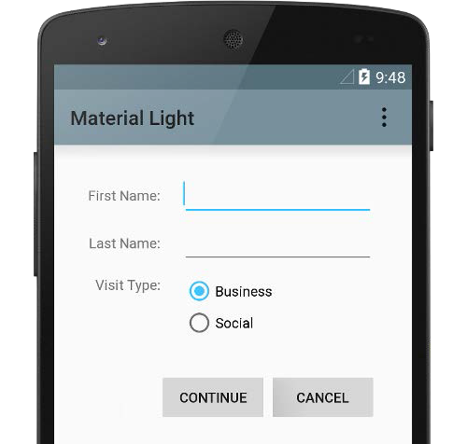
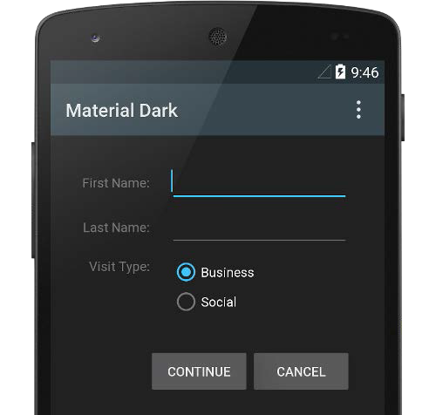
Material Design Theme
Set in AndroidManifest.xml
@android:style/Theme.Material
@android:style/Theme.Material.Light
@android:style/ Theme.Material.Light.DarkActionBar
guidelines
Notes:
Title and Content Slide – Font: Tahoma 12/14 (depending on the amount of text)
Heading: Calibri Heading 26 (consistent)
Bullet code – 174 for bullet
OOBB for sub bullet

Slide 10
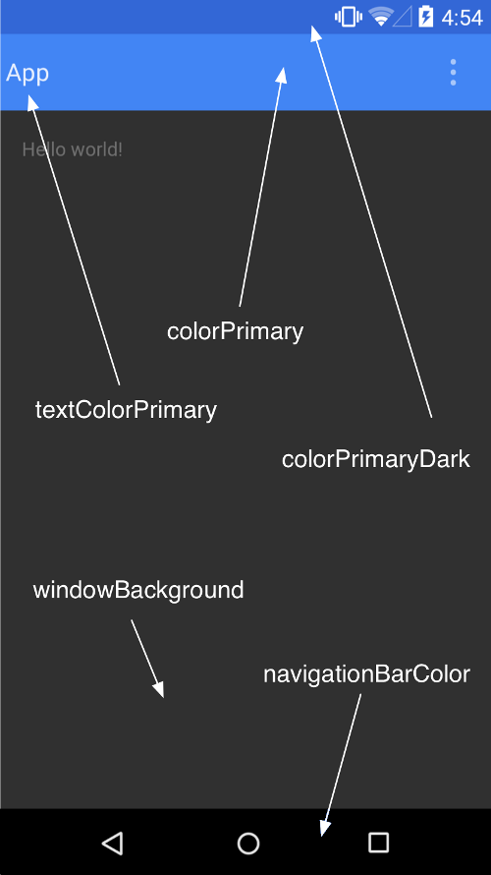
Material Design Theme – Custom Colors
<style name="AppTheme“ parent="android:Theme.Material">
<item name="android:colorPrimary">#3333cc</item>
<item name="android:colorPrimaryDark">#000099</item>
<item name="android:colorAccent">#999933</item>
</style>
Notes:
Title and Content Slide – Font: Tahoma 12/14 (depending on the amount of text)
Heading: Calibri Heading 26 (consistent)
Bullet code – 174 for bullet
OOBB for sub bullet

Slide 11
Toolbar
ToolBar is a generalized ActionBar
More flexible
setActionBar(toolBar)
Option menu actions
Can be placed anywhere in the layout
For example, in a pop up Fragment
Toolbar is just another View
guidelines
Notes:
Title and Content Slide – Font: Tahoma 12/14 (depending on the amount of text)
Heading: Calibri Heading 26 (consistent)
Bullet code – 174 for bullet
OOBB for sub bullet

Slide 12
Toolbar Example
<!–- For example inside some RelativeLayout -->
<android.widget.Toolbar android:id=”@+id/mytoolbar”
android:layout_height=”wrap_content”
android:layout_width=”match_parent”
android:minHeight=”?attr/actionBarSize”
android:background=”?attr/colorPrimary” />
// Inside Activity, after inflating the layout Toolbar toolbar =
(Toolbar) findViewById(R.id.mytoolbar);
Notes:
Title and Content Slide – Font: Tahoma 12/14 (depending on the amount of text)
Heading: Calibri Heading 26 (consistent)
Bullet code – 174 for bullet
OOBB for sub bullet

Slide 13
Toolbar – Standalone with Option Menu
toolbar.inflateMenu(R.menu.mytoolbar_menu);
toolbar.setOnMenuItemClickListener(
new Toolbar.OnMenuItemClickListener() {
@Override
public boolean onMenuItemClick(MenuItem item) {
// Do something
}
});
Notes:
Title and Content Slide – Font: Tahoma 12/14 (depending on the amount of text)
Heading: Calibri Heading 26 (consistent)
Bullet code – 174 for bullet
OOBB for sub bullet

Slide 14
Shadows and Tints – Less Drawables!
Say good bye to shadow.png
<View … android:elevation="8dp" />
Change the color of drawables
drawable.setTint(color);
//XML: android:tint="#ff00ff"
Notes:
Title and Content Slide – Font: Tahoma 12/14 (depending on the amount of text)
Heading: Calibri Heading 26 (consistent)
Bullet code – 174 for bullet
OOBB for sub bullet

Slide 15
Recycler View
Where does its name come from?
Recycled views (aka convert views)
Powerful adapter-backed view
More flexible than ListView and GridView
NOT a framework class (!)
Support library on its own
Gradle dependency
com.android.support:recyclerview-v7:21.0.+
Notes:
Title and Content Slide – Font: Tahoma 12/14 (depending on the amount of text)
Heading: Calibri Heading 26 (consistent)
Bullet code – 174 for bullet
OOBB for sub bullet

Slide 16
Recycler View – LayoutManager
LayoutManager places child views
Must be set in RecyclerView
recyclerView.setLayoutManager(lm);
Default LayoutManagers
LinearLayoutManager (vertical & horizontal)
StaggeredGridLayoutManager
GridLayoutManager
Notes:
Title and Content Slide – Font: Tahoma 12/14 (depending on the amount of text)
Heading: Calibri Heading 26 (consistent)
Bullet code – 174 for bullet
OOBB for sub bullet

Slide 17
RecyclerView.Adapter<ViewHolder>
RecyclerView.ViewHolder contains View
Must be sub-classed, avoids findByView(…)
Implement abstract RecyclerView.Adapter
// create new view and its holder (no binding) ViewHolder onCreateViewHolder(ViewGroup g, int pos)
// bind data values to View
void onBindViewHolder(ViewHolder h, int pos)
int getItemCount()
Notes:
Title and Content Slide – Font: Tahoma 12/14 (depending on the amount of text)
Heading: Calibri Heading 26 (consistent)
Bullet code – 174 for bullet
OOBB for sub bullet

Slide 18
RecyclerView.Adapter – Data Notifications
Problem with notifyDataSetChanged (ListV.)
Which elements have changed?
Individual animations are hard to implement
Fine grained notifications
notifyItemChanged(int)
notifyItemInserted(int)
notifyItemRemoved(int)
notifyItemRangeChanged(int, int)
notifyItemRangeInserted(int, int)
notifyItemRangeRemoved(int, int)
Notes:
Title and Content Slide – Font: Tahoma 12/14 (depending on the amount of text)
Heading: Calibri Heading 26 (consistent)
Bullet code – 174 for bullet
OOBB for sub bullet

Slide 19
RecyclerView.Adapter Callbacks
ViewHolders might use expensive resources like Bitmaps
Callbacks useful to release resources
onViewAttachedToWindow(VH holder)
onViewDetachedFromWindow(VH holder)
onViewRecycled(VH holder)
Notes:
Title and Content Slide – Font: Tahoma 12/14 (depending on the amount of text)
Heading: Calibri Heading 26 (consistent)
Bullet code – 174 for bullet
OOBB for sub bullet

Slide 20
RecyclerView Animations
Item modifications are animated by default
Customize with RecyclerView.ItemAnimator
// Parameters: ViewHolder + change info animateAdd(…)
animateChange(…)
animateMove(…)
animateRemove(…)
// Plus some house keeping methods
Notes:
Title and Content Slide – Font: Tahoma 12/14 (depending on the amount of text)
Heading: Calibri Heading 26 (consistent)
Bullet code – 174 for bullet
OOBB for sub bullet

Slide 21
Android Runtime(ART)

Slide 22
Android VM Basics : Dalvik
No Java VM
Dalvik VM
Java source –> class -> DEX
DEX: Dalvik executable, register-based
JIT compiler since Android 2.2
Several optimizations, but Unlike Java, Dalvik never challenged native
Notes:
Title and Content Slide – Font: Tahoma 12/14 (depending on the amount of text)
Heading: Calibri Heading 26 (consistent)
Bullet code – 174 for bullet
OOBB for sub bullet

Slide 23
ART – The New Android Runtime
First appearance in Android 4.4, Dalvik is still default, ART is somewhat hidden
Replaced Dalvik in Android 5.0
Ahead of time compilation (AOT)
Better Garbage Collection (GC)
64 bit support
Better Profiling and Debugging
Under documented
Notes:
Title and Content Slide – Font: Tahoma 12/14 (depending on the amount of text)
Heading: Calibri Heading 26 (consistent)
Bullet code – 174 for bullet
OOBB for sub bullet

Slide 24
ART – Ahead of Time Compilation
Compilation during installation
Installation takes longer
More storage required (DEX + Compiled)
Better startup time
No compilation lags during execution
Compiled ART code is faster than compiled Dalvik code
Better battery life, less memory consumption
Notes:
Title and Content Slide – Font: Tahoma 12/14 (depending on the amount of text)
Heading: Calibri Heading 26 (consistent)
Bullet code – 174 for bullet
OOBB for sub bullet

Slide 25
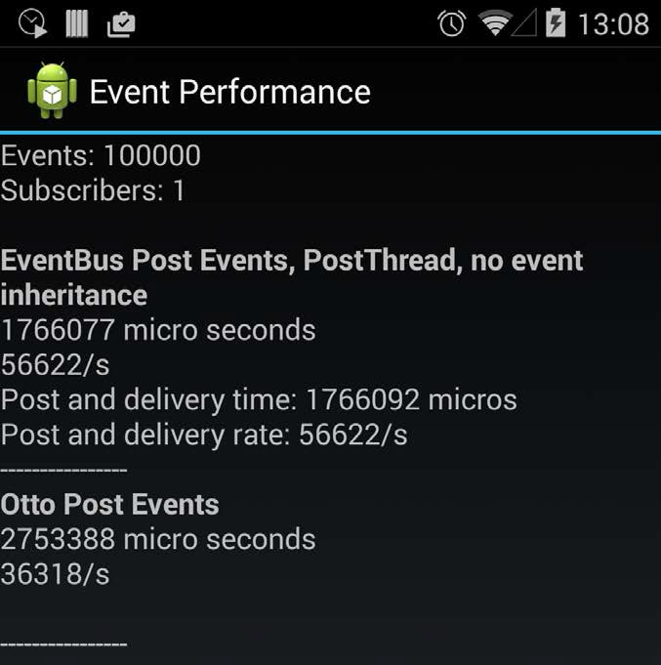
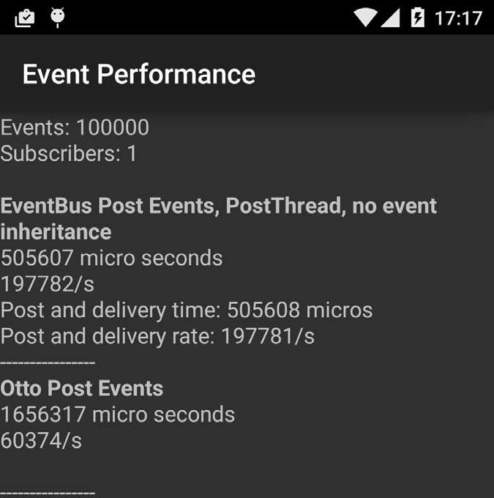
ART – Android 4.4 vs. 5.0 Performance
Reference : ~80,000 Events Dalvik 4.4
Notes:
Title and Content Slide – Font: Tahoma 12/14 (depending on the amount of text)
Heading: Calibri Heading 26 (consistent)
Bullet code – 174 for bullet
OOBB for sub bullet

Slide 26
WebView
Chromium 37
WebGL
WebAudio
Updateable from Google Play (!)
Target SDK 21 has different defaults
Blocks mixed content (HTTPS & HTTP)
Blocks 3rd party cookies
Permissions for camera, microphone, etc.
Notes:
Title and Content Slide – Font: Tahoma 12/14 (depending on the amount of text)
Heading: Calibri Heading 26 (consistent)
Bullet code – 174 for bullet
OOBB for sub bullet

Slide 27
We could go on and on and on..
Even more powerful Notifications
Privacy setting for lock screen
Heads up notifications (floating)
Camera2 API, deprecates Camera
More control, burst mode, etc.
Job scheduling to save battery
Enqueue jobs and let the system decide when to run
Notes:
Title and Content Slide – Font: Tahoma 12/14 (depending on the amount of text)
Heading: Calibri Heading 26 (consistent)
Bullet code – 174 for bullet
OOBB for sub bullet

Slide 28
Compatibility and Support Libraries

Slide 29
Support Android 5.0 Optionally
Set target level in Manifest
android:targetSdkVersion="21“
Check version in code
if (Build.VERSION.SDK_INT >= 21) {…}
Use version qualifiers for resource folders
values-v21/
Notes:
Title and Content Slide – Font: Tahoma 12/14 (depending on the amount of text)
Heading: Calibri Heading 26 (consistent)
Bullet code – 174 for bullet
OOBB for sub bullet

Slide 30
App Compact Library V2 1
History: Started with ActionBar, etc.
ToolBar
Material Theme with customizable colors
Tinting for some Views (Toolbar, Checkbox, …)
Android 5.0 SearchView Widget
Notes:
Title and Content Slide – Font: Tahoma 12/14 (depending on the amount of text)
Heading: Calibri Heading 26 (consistent)
Bullet code – 174 for bullet
OOBB for sub bullet

Slide 31
App Compact Library V2 1 - Integration
For Android 2.1+ (API level 7)
Depends on the v4 Support Library Fragments, etc.
Gradle dependency
compile "com.android.support:appcompat-v7:21.0.+"
Notes:
Title and Content Slide – Font: Tahoma 12/14 (depending on the amount of text)
Heading: Calibri Heading 26 (consistent)
Bullet code – 174 for bullet
OOBB for sub bullet

Slide 32
More Support Libraries related to Lollipop
Palette
Extract primary colors from Bitmap
com.android.support:palette-v7:21.0.+
Card Views
Uses elevation on Android 5.0
Shadow fallback for Pre-5.0
com.android.support:cardview-v7:21.0.+
Notes:
Title and Content Slide – Font: Tahoma 12/14 (depending on the amount of text)
Heading: Calibri Heading 26 (consistent)
Bullet code – 174 for bullet
OOBB for sub bullet

Slide 33
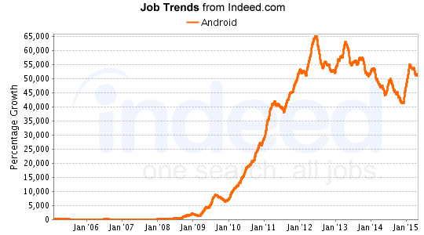
Job Trends
Notes:
1 min

Slide 34
Course Topics
Module 1
Introduction to Android Development
Module 2
Android Layouts and Widgets
Module 3
Activity and Fragments, Notifications and Media
Module 4
Customizing Widgets and Implementing Event Receivers
Module 5
Storage and Animations
Module 6
Web Services
Module 7
Location and Google Maps
Module 8
Database Framework & Third Party Libraries
Module 9
Sensors and Social Media Integration
Module 10
End-to-End App Development & Publishing

Slide 35
For Queries:
Post on Twitter @edurekaIN: #askEdureka
Post on Facebook /edurekaIN

Slide 36
How it Works

